Slide 1




Resilient Communities: Your opportunity for Funding, Networking and Support

Slide 2

Agenda
15:15 – 15:30 – Welcome & Tea
15:30 – 15:40 – ICB new Neighbourhood Services Model (Ravi, WCA)
15:40 – 15:45 – Lived Experience survey (Jessica, WCA)
15:45 – 15:50 – Immunisation Fund (Immunosuppression) (Jessica, WCA)
15:50 – 16:00 – Women’s Health Fund (Jessica, WCA & Beau, Merton Connected)
16:00 – 16:15 – London Resilient Communities Project (Groundworks)
16:15 – 16:30 – Questions & Additional funds (time permitting)
16:30 – 17:00 – Networking, snacks, drinks, close
Notes:
https://www.smartsurvey.co.uk/s/SY5H73/
https://healthwatchwandsworth.us5.list-manage.com/subscribe?u=c14e3cf357987692d83ff28c8&id=7e43047989

Slide 3

Welcome & Purpose

Slide 4
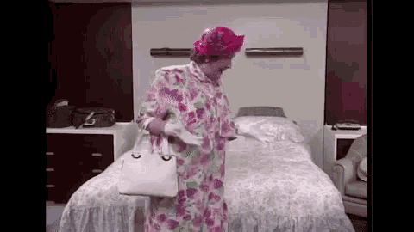
Venue space match up
Blue stickers – Have a community space in the area
Pink stickers – Looking for a community space for activities

Slide 5
Neighbourhood Health Services
(Wandsworth)
Ravi Vyas – Wandsworth Care Alliance (on behalf of the ICB)

Slide 6
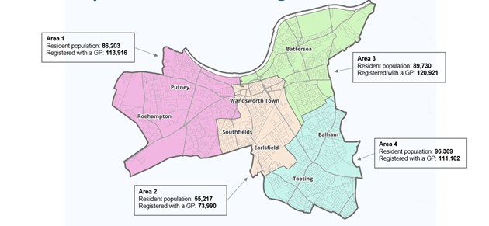
Neighbourhood Health Services - Intro
The ICB are creating four key areas (Neighbourhoods) to collaborate between organisations & bring services closer to residents
The main aims are to:
- Keep people well and out of hospital.
Organise services around people and communities with similar needs.
- Provide personalisation and convenience (a priority in the NHS Ten Year Plan).
- Develop collaborative working not just within statutory health and social care organisations.
- Looking at things wider than health services such as housing, employment, education, local policing, and economic development.
Notes:
https://www.smartsurvey.co.uk/s/SY5H73/
https://healthwatchwandsworth.us5.list-manage.com/subscribe?u=c14e3cf357987692d83ff28c8&id=7e43047989

Slide 7
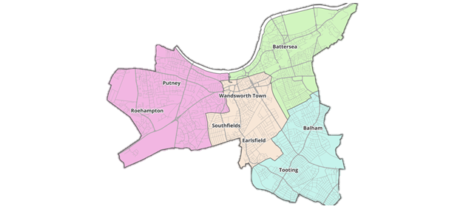
Neighbourhood Health Services – your thoughts
How it will work
- Integrated Neighbourhood Teams – an NHS model being rolled out nationally, bringing together NHS and council organisations.
- Different ways of working – organisations using existing resources differently, focusing initially on adults most at risk of hospital admission.
- Partnerships with communities and the voluntary sector – ensuring that services remain focused on the people who use them, not just the organisations delivering them.
The details are still emerging and will continue to develop over the coming years.
Where we need your thoughts:
– What are your questions?
– What can we as a voluntary sector start doing now to prepare?
– What do you think are advantages of the proposed neighbourhoods?
– What challenges do you see, and how could they be overcome?
Please speak to me to share your thoughts. We will take these down and share them with the ICB.
Notes:
https://www.smartsurvey.co.uk/s/SY5H73/
https://healthwatchwandsworth.us5.list-manage.com/subscribe?u=c14e3cf357987692d83ff28c8&id=7e43047989

Slide 8
Local Opportunities
Lived Experience Survey (Wandsworth)
Jessica Johnson - Wandsworth Care Alliance

Slide 9
The project
Initial request:
  Develop the existing Wandsworth Co-Production and Partnerships Group
  Draft a Co-Production charter
Survey
  Attend any forums/group meetings
  Lived experience of adult social care
Notes:
Wandsworth Council’s Adult Social Care Department.
Increase uptake/expand members
Create a steering group
See what would make people more likely to attend
Co-Production charter, to embed co-production practices
Survey creation to aid in the development of a charter
Asking things like:
What good co-production looks like
What would make you feel empowered to share your views?
Barriers/enablers in attending meetings

Slide 10
Local Opportunities
Vaccine Hesitancy Within Immunosuppressed Cohorts (Wandsworth)
Jessica Johnson – Wandsworth Care Alliance

Slide 11
The project
Early 2025:
  Investigating vaccine hesitancy within Afro-Caribbean and South Asian communities
New project:
  Investigating vaccine hesitancy within Immunosuppressed cohorts
  Current stage: data collection
  Going forward: Follow-up event
Speak to me if you’re interested in taking part!
Notes:
Early 2025
Gave 10 organisations £1,000 to host events to speak about vaccine and vaccine hesitancy
Some of the things we heard:
People were worried about: side effects, how the vaccine works, age-specific risks
Language/cultural barriers
Current stage: Data collection
-Short survey / focus groups – we have small funds that can cover the costs of an event
Going Forward: follow-up event
Opportunity to speak to a clinician, Q&A, opportunity to get vaccinated if people wish

Slide 12
Local Opportunities
Women’s Health Fund (Merton & Wandsworth)
Jessica Johnson – Wandsworth Care Alliance
Beau Fadahunsi – Merton Connected

Slide 13
The project
Grants of up to £2,000 for projects to improve awareness, education and self-management of women’s health (particularly in areas such as menopause, urogynaecology and menstrual health).
Deadline: 20th October 2025, 5pm
You can apply to deliver at least one of the following:
  Targeted and culturally specific workshops/activities
  One large-scale, expert-led online or in person learning event attended by up to 250-300 people and/or a series of learning vents that reach 250-300 people in total
  School-based menstrual health education programmes
Notes:
Community based gatherings/workshops/other initiatives providing women with a safe and familiar space to discuss the topics above. VCSE orgs. will be expected to nurture and empower up to 3 local advocates/champions from their own communities who can support in running the activities and then continue to engage with women around their health after the project has ended
E.g. webinars/Q&As/Workshops – addressing the topics above, designed to be accessible, culturally appropriate and scalable across local populations
To improve understanding among young girls, to reduce stigma, and promote long-term well-being. VCSE groups applying for this type of project will need to prove they are already working in schools.

Slide 14
The funding programme will be targeting women who struggle to access traditionally delivered NHS services in the following areas:
Falconbrook
Furzedown
Latchmere
Queenstown and Battersea
Roehampton
Shaftesbury
Cricket Green
East Merton
Figges Marsh
Lavender Fields
Pollards Hill
Notes:
Left – Wandsworth
Right - Merton

Slide 15
Provided:
  Patient information leaflets
  Links to reputable resources and power point presentations
  List of NHS clinicians (requests must be sent at least 5 weeks in advance, please include £100 in your budget for this)
  Training session for successful organisations and their champions need to attend (20th November)
Notes:
You can invite your own clinicians, as long as the clinical information provided during the session is in line with NHS guidance

Slide 16
Any Questions?
Grant: Up to £2,000
Deadline: 20th October, 5pm!
jessica@wandcareall.org.uk

Slide 17
London-wide opportunity
London Resilient Communities – Groundwork
Ian Morris - Groundwork

Slide 18




London Resilient Communities
London's diverse communities more resilient in the face of emergencies, through development of community emergency plans and establishment of community resilience hubs
Notes:
Vision that the programme aspires to help reach

Slide 19

What is community resilience?
Prepare
Recover
Respond
Mitigate
Notes:
So what is community resilience?
Well we know that when there are emergencies and when things go wrong, community and faith organisations step up and support their communities.
That might be through providing a space to feel safe and comfortable, it might be signposting and advice, community interpreting, social activities, community connection, mental health support, practical support, capturing their views and feelings after the incident, or something else.
We want to help communities to feel prepared, so that when an emergency happens, they have a plan in place, people who they can ask for help, and the knowledge they need to make the best decisions.
Community Resilience is the ability for communities to better prepare for, respond to and recover from emergencies.
Put another way, resilience is the ability to experience a crisis or emergency but have the skills, preparation and relationships to cope with it.
For this programme, we want to give communities the skills and resources they need to respond in an emergency
Mitigate – stop it happening again

Slide 20
What do we mean by a community?
It could be ...
A WhatsApp group on an estate
An organisation that supports a cultural or diaspora group
A local volunteer centre
A pan-London LGBTQ+ support group that meets online
Worshippers at a mosque, church, temple or other place of worship
A community garden group
Parents and carers of children with additional needs
Notes:
Communities can include geographic communities (e.g. your neighbourhood, estate, borough), faith communities, cultural or ethnic communities, the LGBTQ+ community, those bound by a particular interest or passion, those who are disabled and those who live with ill health etc
When we say communities, we might be talking about and of those in the list, or we might be talking about something else.
We're very open to how a community is defined.

Slide 21
Ways that communities provide support
A list of people to contact for signposting and advice
Know how to support with community interpreting
Holding a social/event to gather people together
A listening service
Practical support
Holding a 'listening' session to capture views and experiences
Becoming a community resilience hub
Notes:
What does Community Resilience look like?
Here are some practical examples.
What community resilience looks like differs from one community to another, and needs to be led by them – they would take on what they think is best suited for their community.

Slide 22
"We are all in the same storm, but in very different boats"
Notes:
We know that we don't live in an equal society – and Covid-19 and other emergencies made that clearer than ever.
We know that communities which are affected by racism, ill health, disability prejudice and discrimination, poverty and poor housing are first and worst affected by the challenges we face.
We really want to connect with groups who are less heard, less supported and who have more struggles.
We know that their strength and resilience can bring so much to the programme – we want to support communities to build on the resilience which they already have, to feel more confident in responding to emergencies.

Slide 23
How did we get here?
We are living in times of increasing emergencies
We know that communities respond to help those in need in emergencies
We've heard from communities that they need support to engage in resilience work – training, resources and financial support
London Community Resilience Toolkit
Community Resilience Hubs Venue Mobilisation Programme
Notes:
London has faced many emergencies — from the COVID-19 pandemic and the cost-of-living crisis to fires, flooding, and extreme weather linked to climate change.
Inequalities mean some communities are affected more than others.
Community and faith groups already play a vital role: offering safe spaces, advice, translation, social connection, mental health and practical support.
This programme will help you feel more prepared — with a plan, people you can call on, and the knowledge to make good decisions when emergencies happen.
This programme builds on three previous projects, funded by the GLA:
London Community Resilience Toolkit – a toolkit created for London communities, including charities, community groups, and faith organisations to support them to become more resilient and develop their own community emergency plan.
Community Resilience Hubs Venue Mobilisation Programme – a project to test out research from Imperial College on the creation of ‘Community Resilience Hubs’ with three venues.
Climate Connected Communities – a project to equip community representatives with the knowledge, skills, and connections to help their communities prepare for, respond to, and recover from climate challenges through training, networking and signposting.

Slide 24
What we want to achieve
Communities create Community Emergency Plans
Venues that serve communities become Community Resilience Hubs
Notes:
London’s communities will be more resilient in the face of emergencies. We will achieve this through working with community, voluntary and faith sector partners to support them in:
Creating Community Emergency Plans.
Establishing Community Resilience Hubs, that coordinate local resilience activities.
We will provide support, advice, training and resources to enable communities to take part.
A grant programme will also be open during November 2025 for applications to provide further support.
Engagement in the programme will be led by communities, with their interests, priorities and values being integral to the work undertaken.

Slide 25
What this programme will involve
Online Training & Resources
  On different hazards, including flooding and extreme heat
  Other topics such as volunteering and community engagement
Small Grants for Community Resilience
  Supporting communities with a structured approach to become more resilient
Notes:
An online programme of training (available both live and recorded for later viewing), resources and templates exploring different ‘resilience’ topics, from flooding to creating a community emergency plan.
A tiered small grant scheme to support communities to create new community emergency plans and become community resilience hubs
As the programme progresses, we will learn from communities, feeding into a review of the London Community Resilience Toolkit as well as engagement with the London Resilience Equalities Partnership.

Slide 26
London Resilient Communities – Programme values
Supportive
Community Led
Impactful
Notes:
The programme will be:
Supportive – with small grants, training and resources to help you build resilience
Community-led – shaped by your priorities and values
Impactful – empowering groups across London to make a difference at scale
The aim of this programme is to start something – this is the start of a journey towards all communities feeling prepared and resilient

Slide 27
Timeline
September
Engagement phase
October
Engagement phase
November
Grant scheme opens and closes
December
Assessing applications
January to April
Venues take steps to become Community Resilience Hubs
Webinars, training and support uploaded monthly
Communities create Community Emergency Plans
Informing applicants
May
Grant reporting

Slide 28
Open to everyone
Monthly webinars on different topics and themes to increase knowledge and skills – these will also be recorded and available for viewing at any time
Resources and templates to support the development of community emergency plans and organisations becoming community resilience hubs
Notes:
Everyone – whether successful in the grant scheme or not – will have access to the following

Slide 29
Grants
Grant | Amount | What it can support | Who can apply | How it’s paid
Toolkit Grant | £500 | • Mapping your local stakeholders and assets • Creating a community emergency plan | Community, voluntary, or faith groups (no need for a separate bank account) | Paid once your project is completed and a short monitoring form is approved
Hubs Grant | £1,000 | • The activities above • Developing a space that can be used as a Community Resilience Hub | Community, voluntary, or faith groups (you will need a separate bank account). You’ll also need to let your local authority emergency planning team know before applying – we’ll provide their contact details. | Paid once your project is completed and a short monitoring form is approved
Notes:
To support our aims, we will provide a small grant programme that will support with this activity
The training and support programme will start in January – and be wrapped up in the spring

Slide 30
What to do now?
Sign-up to the programme – go to the website
Have a look at the London Community Resilience Toolkit
The grant programme opens at 10am on Monday 3rd November 2025 and closes at 12 noon on Monday 1st December 2025
Get in touch with us if you have any questions
Please share far and wide about this programme to help spread the word and benefits!
Notes:
Post the links in the chat

Slide 31
Get in touch
https://www.groundwork.org.uk/london-resilient-communities/
Londonresilience@groundwork.org.uk
Notes:
Thanks everyone

Slide 32
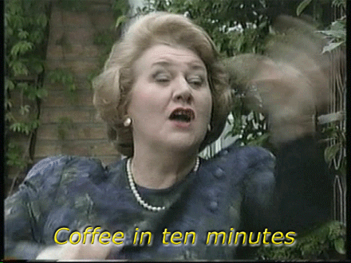
Some more opportunities
Local open funds

Slide 33
Local funds
Wandsworth Grant Fund – (£500-£10K)
For: Raising aspiration and potential, Environment and attractive neighbourhoods, Children and young people, Citizenship and civic engagement or Health and wellbeing
Deadline: 10am, Monday 10th November. Click here for more information.
Borough of Sanctuary Fund – (up to £10K)
For: Celebrating refugees and asylum seekers, Supporting sanctuary seekers’ wellbeing, Expanding organisational capacity, Integrate sanctuary seekers into UK and local life
Deadline: 10am, Monday 3rd November. Click here for more information. Meet the funder – 17th October & 22nd October
Culture Micro-commissions – (up to £1K)
- For: Wandsworth based creatives, to create new art pieces that enrich the borough and showcase its culture
Deadline: Rolling until December 2025. Click here for more information.
Notes:
https://www.smartsurvey.co.uk/s/SY5H73/
https://healthwatchwandsworth.us5.list-manage.com/subscribe?u=c14e3cf357987692d83ff28c8&id=7e43047989

Slide 34

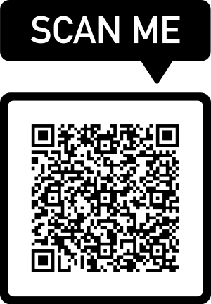
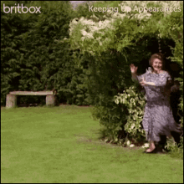
Thank you!
Volunteer recruitment workshop – 21st October (online)
Volunteer Involving Organisations – 18th November (online)
Healthwatch Assembly – 20th November (Tooting)
Please speak to us and register for the funds, events, and anything else!
Alliances: please scan the QR code or click to arrange our next meeting:
Feedback Forms!
Emails:
ravi@wandcareall.org.uk
jessica@wandcareall.org.uk
beau@mertonconnected.co.uk
londonresilience@groundwork.org.uk
Sign up to our newsletter & monthly funding bulletin here

Slide 35
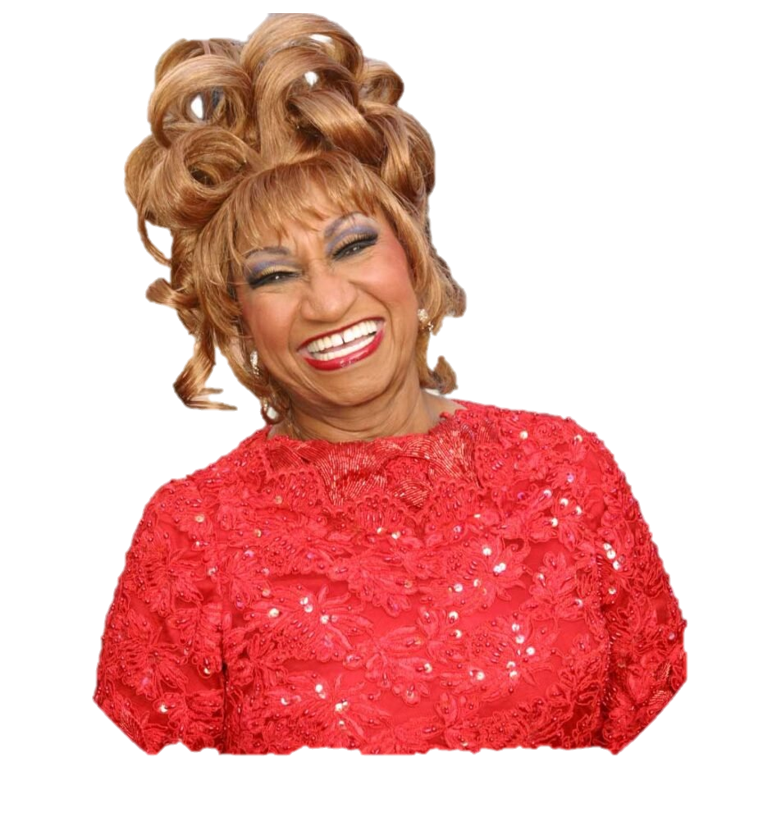
Kimbara Kimbara Kuma Kim Bamba
Kimbara Kimbara Kuma Kim Bamba
Celia Cruz
Azúcar!

